Slide 1
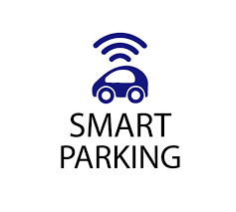
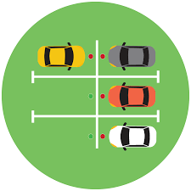
Smart Car Parking System Using IOT
By :-
SARANSH BHATNAGAR
GAUTAM JAISWAL
RISHABH DHAWAD
OJAS KHATAVKAR

Slide 2
Contents ➤Objective ➤Introduction ➤ Existing System ➤ Proposed system ➤ Block Diagram ➤ Component Description ➤ Project planning ➤ Flowchart ➤ Advantages ➤ Applications ➤ Conclusion

Slide 3
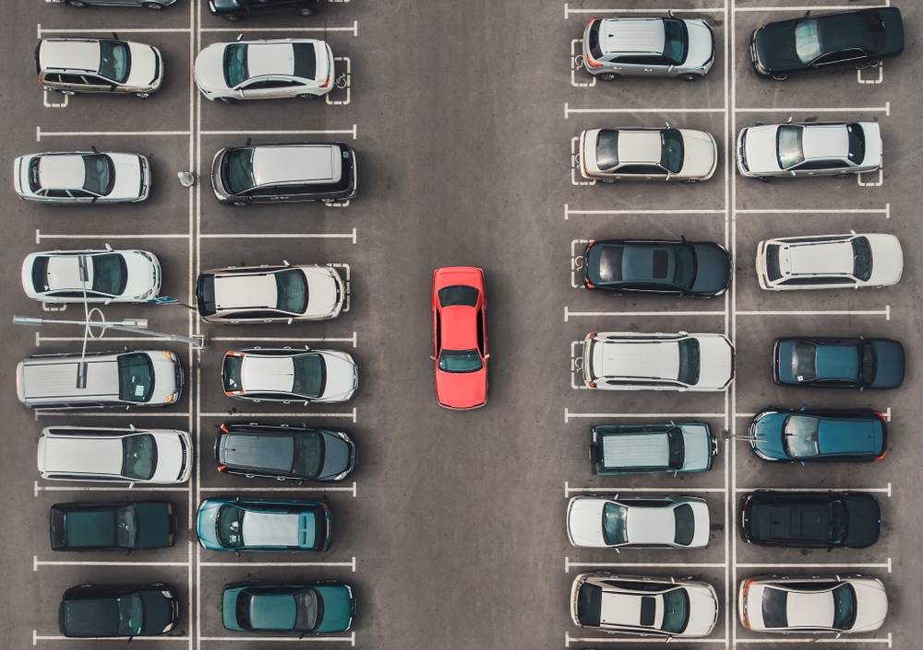
Objective:-
The main aim of this project is reduces the risk of finding the parking slots in any parking area.
It eliminates the unnecessary travelling of vehicles across the filled parking slots in a city
To reduce the time taken and the hassle factor of locating an available parking space.

Slide 4
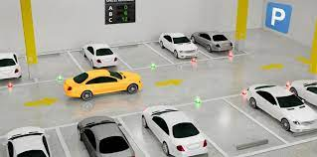
Introduction:-
Smart Car Parking System is an integrated system to organize cars in public areas.
All vehicles enter into the parking and waste time for searching for parking slot.

Slide 5
Existing System:-
The problem in the existing system is whether parking slot is available or not doesn't know before reach the parking area.
Creates congestion and reduces the real estate available for more important purposes, such as housing, transit, parks and public space.
Parking also contributes to urban sprawl by increasing the distance between each building.

Slide 6
Proposed system:-
The convenience factor is of particular importance for spaces reserved for disabled drivers, public service or emergency vehicles.
Reduced Traffic. When a driver knows exactly where they need to go; it reduces idling and unnecessary driving – therefore optimizes traffic flows in built-up areas.
Real-Time Data and Insights Smart Parking provides you with rich data-sets that can be used to identify trends, peak-times and other metrics

Slide 7
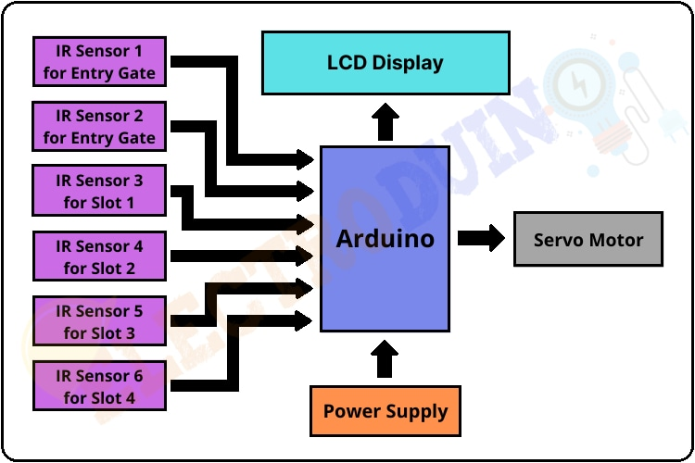
Block Diagram:-

Slide 8
Component Description
Arduino Uno R3
Breadboard
LCD
Potentiometer
Resistors
Ultrasonic Distance Sensors
Connecting probes

Slide 9
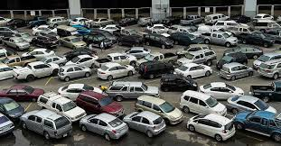
Project planning:-
Implementation of the proposed system.
To study components of Software & Hardware.
Experimental setup of proposed design.
Checking the output by writing appropriate code.
Result & Discussion.

Slide 10
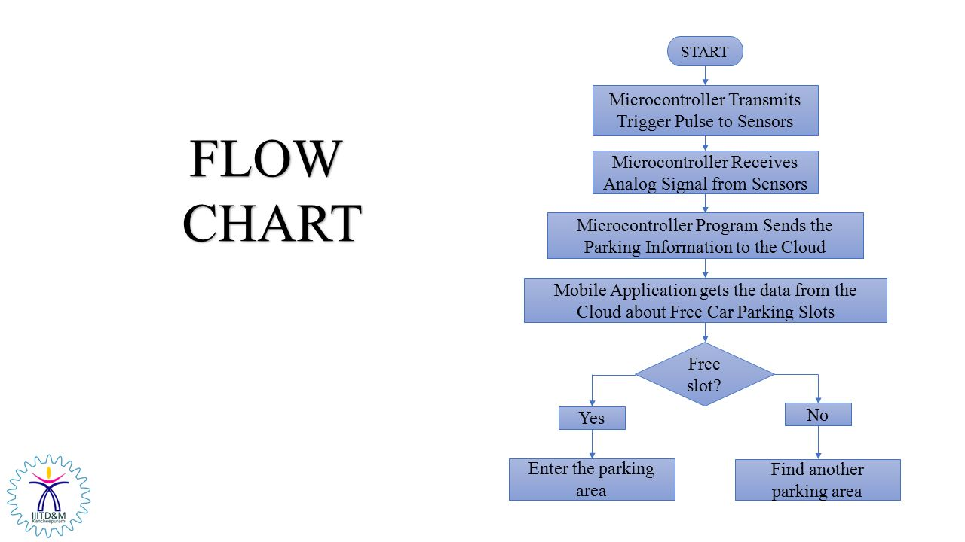
Flowchart:-

Slide 11
Working:-
When car enters the parking area IR sensor that is present before IN gate will detects the passing vehicle and the gate will be opened automatically.
The car will enter into the parking area at that time person doesn't know which slot is empty, for this there will be an indication of LED's for every slot when the Green light glows the slot is empty when the red light glows the slot was filled. By this the person easily know which slot is empty.
The operation of exit side will be same as that of the entrance. When the car is leaving the parking area, the IR sensor that is present before the OUT gate will detect the passing vehicle and the gate will be opened automatically.
In front of the parking area, there will be an LCD display that is used to show the status of the parking slots, whether the parking is available or not.

Slide 12
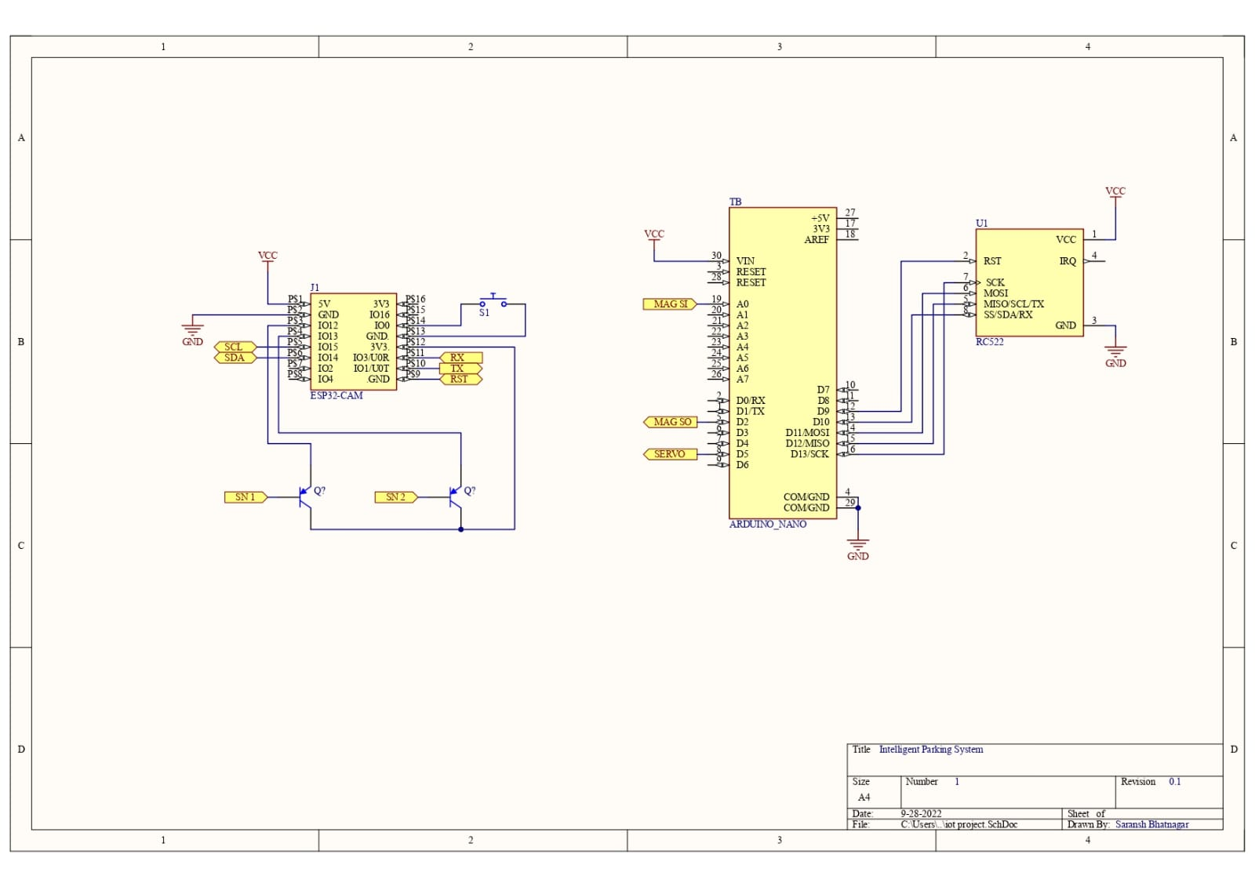
Circuit Design:-

Slide 13
Advantages:-
Shorter waiting time at parking place.
It saves fuel, money, space and time.
Reduced pollution.
Reduced traffic.
Carbon emission is reduced.
Efficiency

Slide 14
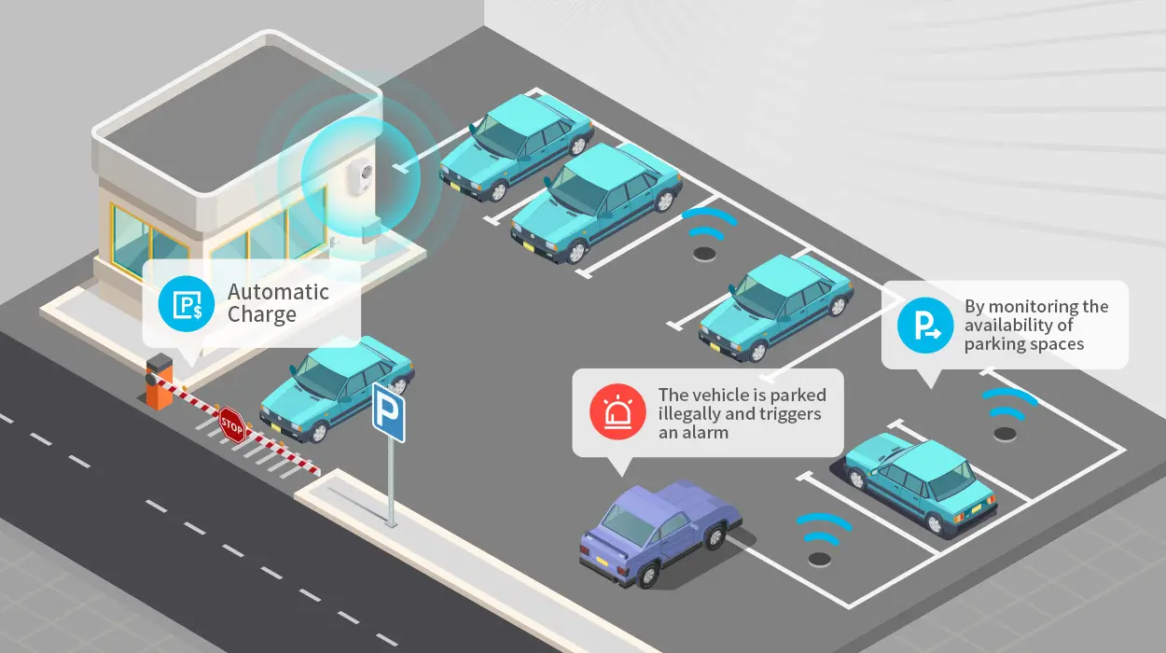
Applications
At schools
At hospital
At colleges
At gyms
At malls
At metro stations

Slide 15
Conclusion:-
This project focuses on implementation of car parking place detection using Internet of Things.
The system benefits of smart parking go well beyond avoiding time wasting.
Developing a smart parking solutions with in a city solves the pollution problem.

